Slide 1
TCP Basics (Part I)
Presenter:
Assist. Prof. Dr. Fatih ABUT

Slide 2
Introduction to TCP
Point-to-point connection
Reliable data transfer
Streaming interface
  Byte-oriented
  No boundaries for fragments/segments
Full duplex
Flow and congestion controlled
Protocol implemented entirely at the ends

Slide 3
Benefits of TCP
Communication is ‘transparently reliable’
Data is delivered in the proper sequence
An application programmer does not need to worry about issues such as:
  Lost or delayed packets
  Timeouts and retransmissions
  Duplicated packets
  Packets arriving out-of-sequence
  Flow and congestion control

Slide 4
Overview
application layer
process A
process B
transport layer
…
port P
…
…
port Q
…
T C P
reliable TCP
byte-stream connection
T C P
network layer
I P
I P
unreliable IP datagrams

Slide 5
What is a ‘connection’?
An application’s socket is ‘connected’ if it has a defined pair of socket-addresses:
  An IP-address and port-number for the ‘host’
  An IP-address and port-numbet for the ‘peer’
138.202.171.14
138.202.192.14
port 53124
port 80
Client, e.g. Browser
Web-server

Slide 6
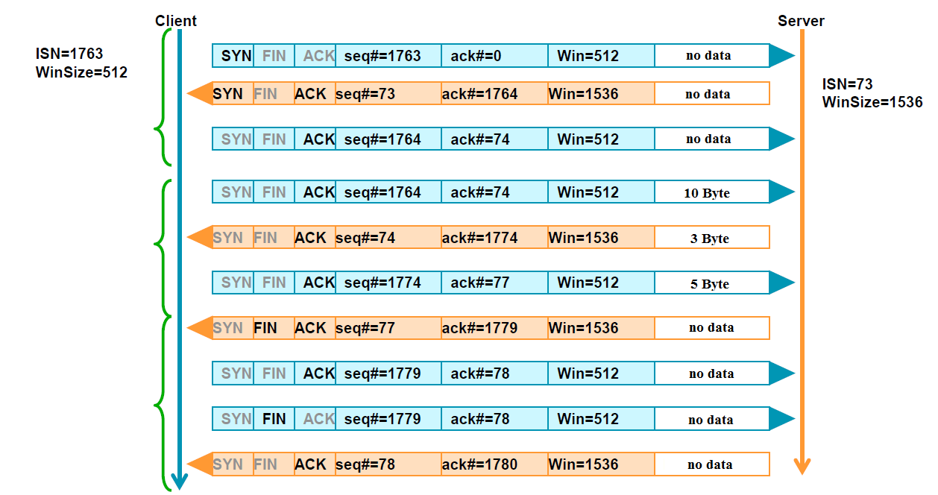
TCP – Normal Procedure (Simplified)
Connection setup
Data transfer
Connection termination

Slide 7

Connection Establishment (cont)
Three way handshake:
Step 1: client host sends TCP SYN segment to server
  specifies a random initial seq #
  no data
Step 2: server host receives SYN, replies with SYNACK segment
  server allocates buffers
  specifies server initial seq. #
Step 3: client receives SYNACK, replies with ACK segment, which may contain data
Host A
Host B
Connection
request
SYN, Seq=42
host ACKs and selects
its own initial seq #
SYN+ACK, Seq=79, ACK=43
host ACKs
ACK, Seq=43, ACK=80
time
time
Three-way handshake

Slide 8
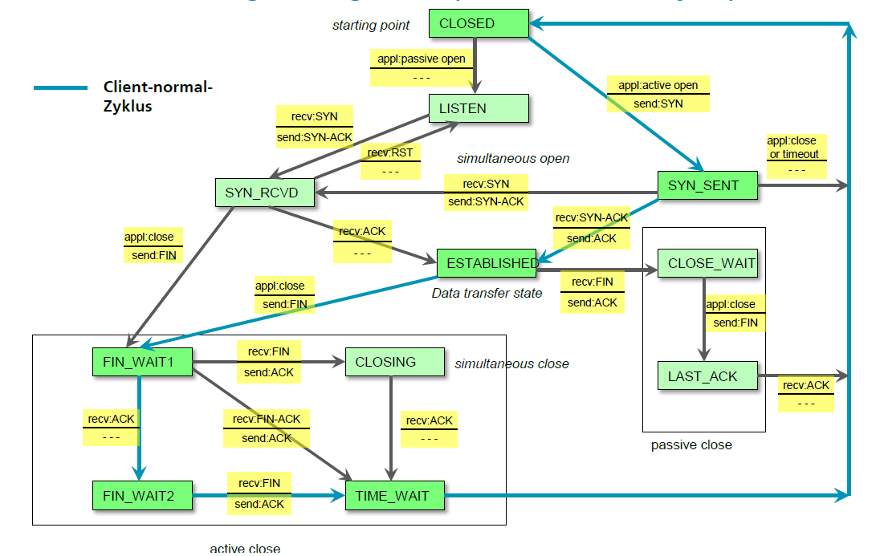
TCP Connection Management

Slide 9
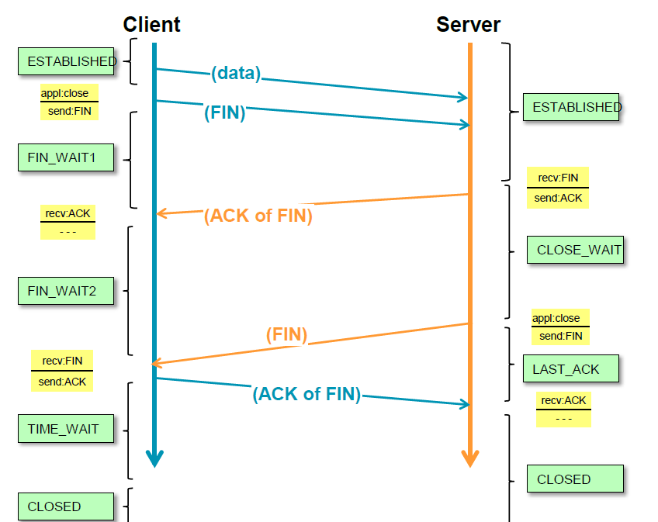
Regular TCP Connection Termination

Slide 10
Evolution of TCP
1975
Three-way handshake
Raymond Tomlinson
In SIGCOMM 75
1984
Nagel’s algorithm
to reduce overhead
of small packets;
predicts congestion collapse
1987
Karn’s algorithm
to better estimate round-trip time
1990
4.3BSD Reno
fast retransmit
delayed ACK’s
1983
BSD Unix 4.2
supports TCP/IP
1986
Congestion collapse
observed
1988
Van Jacobson’s algorithms
congestion avoidance and congestion control
(most implemented in 4.3BSD Tahoe)
1974
TCP described by
Vint Cerf and Bob Kahn
In IEEE Trans Comm
1982
TCP & IP
RFC 793 & 791
1975
1980
1985
1990

Slide 11
TCP Through the 1990s
1994
T/TCP
(Braden)
Transaction
TCP
1996
SACK TCP
(Floyd et al)
Selective Acknowledgement
1993
TCP Vegas
(Brakmo et al)
real congestion avoidance
1994
ECN
(Floyd)
Explicit
Congestion
Notification
1996
Hoe
Improving TCP startup
1996
FACK TCP
(Mathis et al)
extension to SACK
1993
1994
1996

